Slide 1
JAVA SEMINAR
3. Write a program to implement the RowSet. Rather than establish the connection and create a Statement explicitly the program should uses a JdbcRowSet object to create a Connection and a Statement automatically.

Slide 2
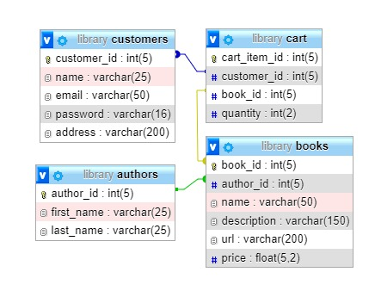
DATABASE:

Slide 3
STEPS:
Create JdbcRowSet object and set database credentials for the object to connect to the database.
Also pass command to the object for output.
Get metadata from rowset object.
Print the details in the rowset by using metadata information like column count and column name.

Slide 4
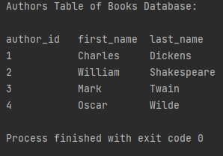
OUTPUT:

